Slide 1
Visual Design
Session 04

Slide 2
OUTLINE
The Look and Feel
Graphic Design Principles
Color Theory
User Interface Design

Slide 3
The Look and Feel
During the early concept stages of a project, there is usually no real technology or code base.
Early design concepts can be tested and rejected with a minimum of effort and very little wasted manpower.
They are used to define qualities such as tone, mood, and style
These concepts are collected into what is sometimes referred to as an Art Bible, a document where all of the best ideas and imagery are kept.
For the artistic vision to maintain a strong presence throughout the development cycle, the game artist must understand and use some basic design principles.

Slide 4
Graphic Design Principles
Graphic design is a communication process through which ideas and concepts are presented in a visual medium.
graphic elements, composition, layout, color and typography, information can be presented in a very powerful and compelling way
Graphic Design principles:
Balance
Rhythm
Emphasis
Unity

Slide 5
Graphic Design Principles
Balance
Balance is the visual equilibrium in a composition.
Symmetrical balance is where objects of equal weight are placed on either side of a central point or fulcrum.
Asymmetrical balance is where objects of nonequal weight are balanced around a point or fulcrum
Example: (next slide)

Slide 6
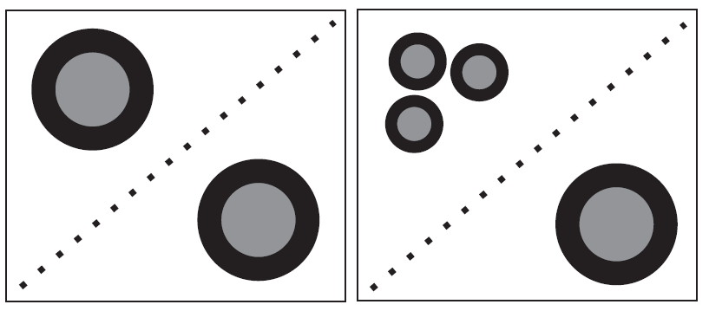
Symmetrical and asymmetrical balance.

Slide 7
Graphic Design Principles
Rhythm
pattern created by repeating various elements within a design
This rhythm produces order and predictability
It also gives movement to a composition, allowing the artist to control the visual energy.

Slide 8
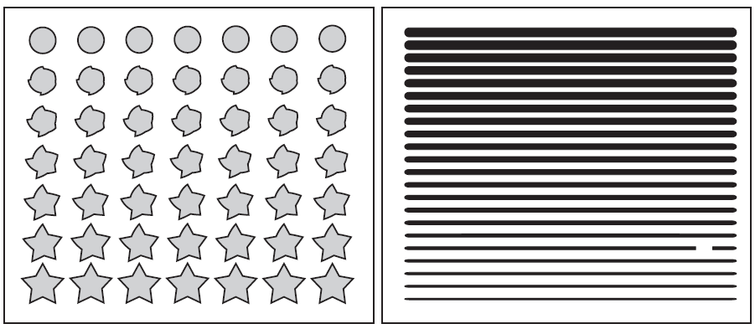
A rhythmic pattern is predictable. To create emphasis and focus
the eye on a specific location, the pattern can be interrupted.

Slide 9
Graphic Design Principles
Emphasis
Emphasis is created when the pattern of movement is interrupted.
The rhythm is broken and forms a focal point, usually drawing the eye to it first.
Emphasis can also be created through repetition and contrasts in elements such as color, size, shape, or

Slide 10
Graphic Design Principles
Unity
the harmony of all parts.
It forms a cohesive whole within a design.
Elements that are in unity look like they all belong together.

Slide 11
Color Theory
We see color in a small portion of the electromagnetic spectrum known as visible light
it is the reflection of light off a surface
All of the other colors are absorbed by the surface, allowing only the color we see to be transmitted
To help define how colors appear, they are broken into several qualities such as hue, saturation, and value.

Slide 12
Color Theory
Hue: Refers to the name of a color within the visible spectrum
Saturation: Refers to the amount of a color. The less saturated a color is, the more gray value is visible.
Value: The amount of white or black that is present in a color. This is often referred to as the lightness or darkness of a color

Slide 13
Color Theory
Color Plate 1
colors that are reflected into our eyes, is known as subtractive color.
Primary colors: Within the subtractive color wheel, there are three primary colors: red, yellow, and blue.
Secondary colors: These colors are formed by mixing the primary colors. They are green, orange, and violet.
Tertiary colors: These colors are formed by mixing one primary and one secondary color. They are yellow-orange, red-orange, red-purple, blue-purple, blue-green, and yellow-green.

Slide 14
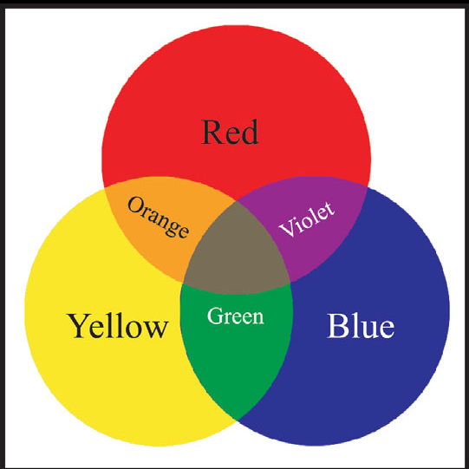
Color Plate 1

Slide 15
Color Theory
Color Plate 2
By mixing one or more sources of light, colors can be achieved using additive color. Because the colors are emissive rather than reflective, they behave and blend differently.
example of something that uses additive color is a television or computer monitor.
Within the games industry, most artwork is created with software that uses the additive color chart.

Slide 16
Color Theory
Color Plate 2
Primary colors: The three primary colors of the additive chart are red, green, and blue
Secondary colors: Equal portions of any two primary colors will yield a secondary color of magenta, cyan, or yellow.
White: Equal portions of all primaries (red, green, and blue) will yield white.
Color harmony: complimentary, split complimentary, triads, and analogous colors. The order, amount, and combination of these colors are where the “art” comes in.

Slide 17
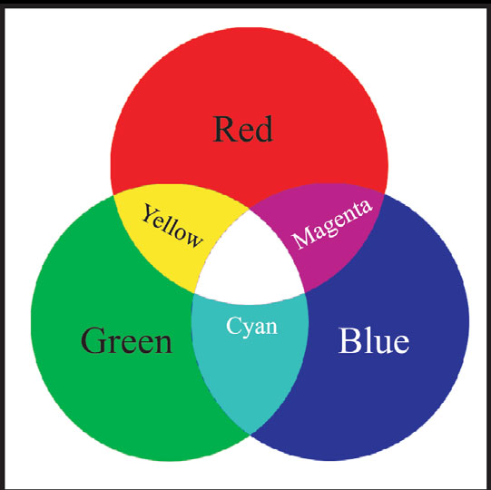

Slide 18
User Interface Design
UI is an important link between the programming code and the end user.
a UI must be predictable, consistent, and informative
Using fundamentals of Graphics Design, however it is only targeted to a noninteractive, one-way presentation
Sound graphic principles are needed.

Slide 19
User Interface Design
Design Considerations
Simplicity
Consistency
Know the target user
Color usage
Feedback mechanisms

Slide 20
User Interface Design
Design Elements
A flow chart of the design is an invaluable tool for spotting errors in design or functionality.
game designer to come up with the functional requirements of the menuing system,
while the artist comes up with how it will look
Creating a UI while the design is still in a major state of flux will lead to rework and wasted art.

Slide 21
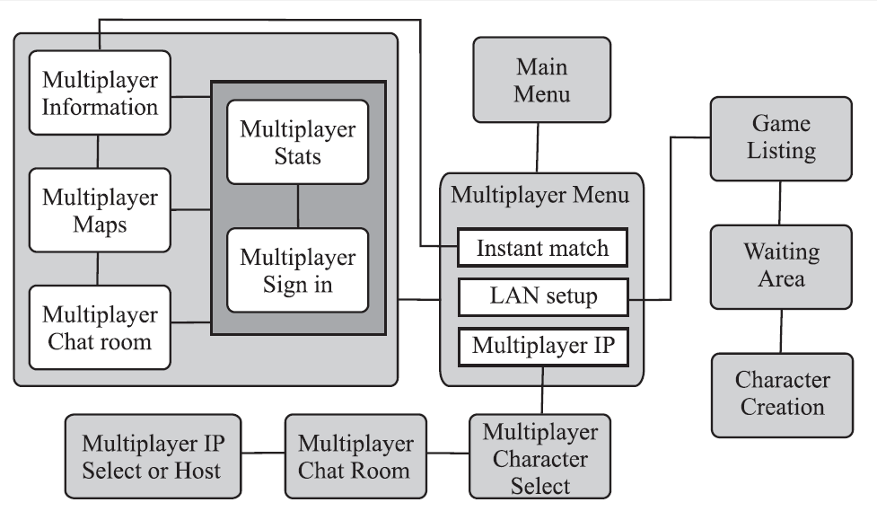
A flow chart helps to visualize a design.

Slide 22
User Interface Design
Design Elements
Establishing a grid
Underlying all good design is a grid.
Tiered menu system
The most powerful menu system is one that can adjust to the needs of the user.
Localization considerations
Overseas sales make up a substantial part of the target market for many of today’s games.

Slide 23
User Interface Design
Design Elements
Typography Fundamentals
Serif versus san serif fonts
International font considerations
Kerning
Hinting
TrueType versus Bitmap Fonts
Creating a Font
Rapid Prototyping

Slide 24
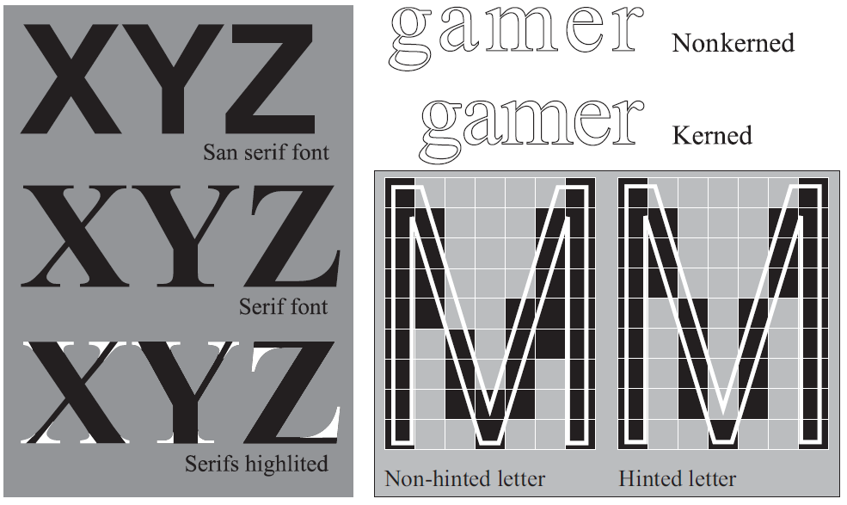
Examples of a serif and sans serif font. Kerning shows the spacing
between letters. Hinting allows text to be reduced and still maintain legibility.

